Slide 1

API Management centric integration
Srinivasa Mahendrakar
mahendrakarsri

Slide 2
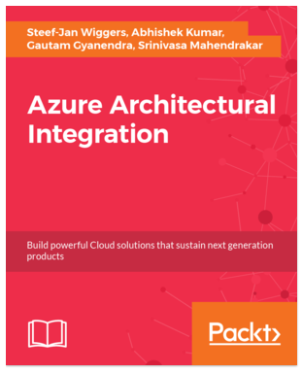
Srinivasa Mahendrakar
Integration consultant(Developer/technical Lead/Architect) with more than 13 years experience in implementing integration solutions
From past 2 years I am working at BizTalk360 as a technical lead
Living in UK
Reach me :
email : srinivasa.mahendrakar@Hotmail.com
linkedin : linkedin.com/in/srinivasa-mahendrakar-bb558721
twitter : @mahendrakarsri

Slide 3



As per Harvard Business Review , These companies generating more than 50% of their revenues through APIs.

Slide 4
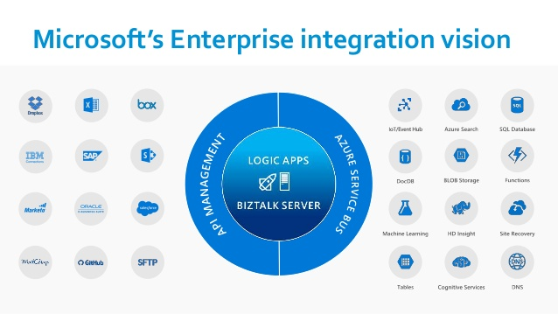

Slide 5
Agenda
API Management Centric Integration
Content based routing (For Production testing)
Introduction to API Management
Integration patterns using APIM
Handling large messages in Hybrid integration scenarios
Logic Apps as reusable services
Expose WCFBasicHttp endpoint to APIM in BizTalk feature pack 2.
Static mocks
Policy expressions

Slide 6
Azure API Management
Publish, manage, secure, and analyze your APIs in minutes

Slide 7
Why Azure API Management?
Package and publish APIs to developers and partners
On-board developers via a self-service portal
Ramp-up developers with docs, samples, and API console
Build an API façade for existing backend services
Reliably protect published APIs from misuse and abuse
Gain insights into API usages and health from analytics reports

Slide 8
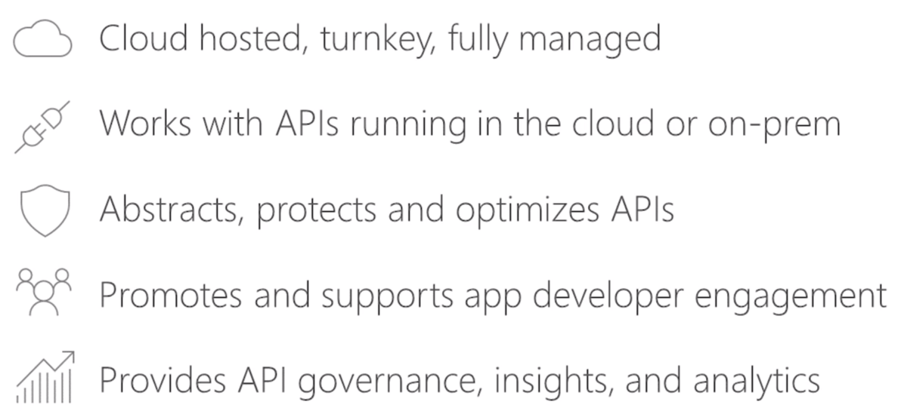
What is Azure API Management

Slide 9
Demo A tour of Azure API Management

Slide 10





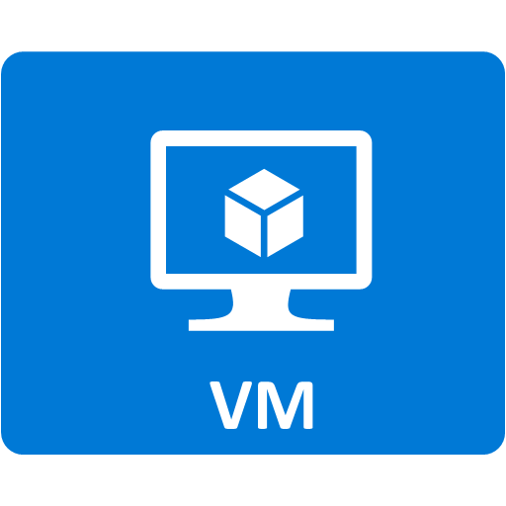




API Management - a hub for enterprise APIs
Discover
Learn
On-board
Try
Get support
SDKs and samples
1st and 3rd party apps
Abstract
Secure & protect
Evolve
Monitor
Analyze
Productize
Monetize
Consume
Mediate
Publish
Developer portal
Gateway
Azure portal
API managers and developers
App developers
APIs on Azure and outside

Slide 11
Policy scopes
GET /foo/bar HTTP/1.1
Host: api.constoso.com
Key: 0123456789
global
CORS
LOG
0123456789
product
from caller
RATE
QUOTA
inbound
to backend
/foo
api
JWT
/bar
operation
CACHE
URL
BODY
to caller
from backend
outbound

Slide 12
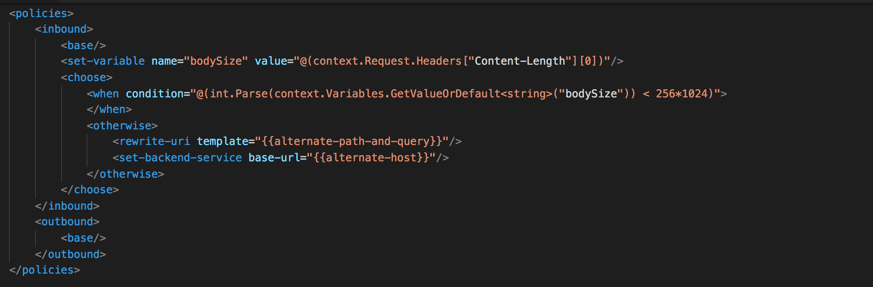
Policy expressions
C# “snippets” embedded in policy documents
Have read-only access to the request context
Can only use whitelisted .NET types
Dynamically configure and conditionally execute policies

Slide 13
Demo APIM policies – return response policy

Slide 14
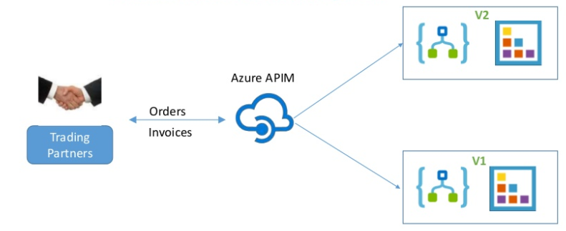
Content base routing using API Management

Slide 15
Demo Content based routing

Slide 16


Handling large message in hybrid integration
1
>256KB
2
<256kb
Service Bus Message size restriction
Standard : 256 KB
Premium: 1 MB

Slide 18
Logic Apps as reusable services
AS2 Service
X12 service
EDIFACT Service
Transformation Service

Slide 19
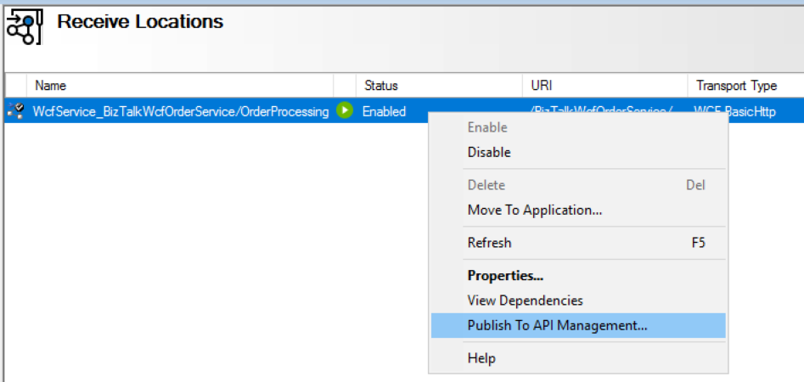
Publish BizTalk SOAP endpoints in API Management
You can expose a WCF-BasicHTTP receive location as an endpoint within Azure API Management using BizTalk Administration.

Slide 20
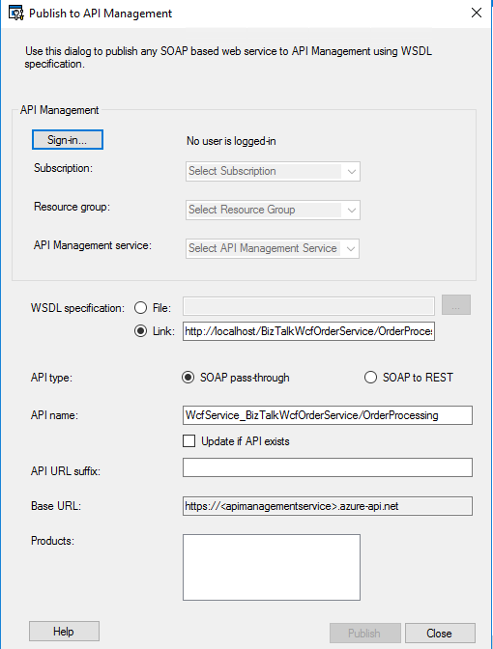
SOAP to REST
SOAP pass-through
Publish your existing SOAP Service
Publish your existing SOAP Service as REST
Full control of exposed REST schema
Full control of translation between REST and SOAP
Prerequisites
Install Feature Pack 2 on the BizTalk Server
Connection BizTalk computer and the API Management instance
VPN
Via your existing firewall
Hosted in Azure

Slide 21
Takeways
APIs are the building blocks of modern apps
They need to be managed, protected and measured
Power of APIs is harnessed by developers
API management is a necessity

